Slide 1
Computer Architecture I
CS-GY-6133
Topic: Single Cycle MIPS Implementation
Instructor: Siddharth Garg

Slide 2
MIPS ISA Overview
32-bit ISA (what does this mean?)
Instruction length: 32 bits
Data word length: 32 bits
32 general purpose registers ($0, $1, $2, … $31); 32-bits each
Register $0 is hard-wired to 0 (constant)
All other registers can be used as read/write
But, certain registers dedicated for specific purposes by compiler
Global pointer ($28), Stack pointer ($29), Frame pointer ($30), Return Address ($31)
We wont worry about these conventions in this class!
Two dedicated 32-bit registers hi and lo for multiplication ops
Separate regs/unit for floating point ops (discussed later)

Slide 3
MIPS Instructions: R-Type
31
26
25
21
20
16
15
11
10
6
5
0
Op-code
(6-bits)
Rs
(5-bits)
Rt
(5-bits)
Rd
(5-bits)
Shamt
(5-bits)
funct
(6-bits)
000000 for all R-type instructions
Operand register identifiers
Result register identifier
Shift amount
Add: 100000 = 20_{hex}
Sub: 100010 = 22_{hex}
Or: 100101 = 25_{hex}
Sll: 000000 = 00_{hex}
add rs, rt, rd // R[rd] ← R[rs] + R[rd]; signed addition; trap on overflow
sub rs, rt, rd // R[rd] ← R[rs] - R[rt]; signed subtraction; trap on overflow
or rs, rt, rd // R[rd] ← R[rs] | R[rt]; bit-wise Boolean OR operation
sll rt, rd, shamt // R[rd] ← R[rt] << shamt; logical shift left
…..(many others)

Slide 4
2’s Complement Representation
add rs, rt, rd // R[rd] ← R[rs] + R[rd]; signed addition; trap on overflow
rs, rt and rd are assumed to contain 32-bit signed, 2’s complement numbers
Example using 4-bit signed complement numbers ([-8,7])
Overflow occurs when result lies outside [-8,7]
1 1 0 1 = -1*2³ + 1*2² + 0*2¹ + 1*2⁰ = -8 + 4 + 0 + 1 = -3
+ 1 1 0 1 = 0*2³ + 1*2² + 0*2¹ + 1*2⁰ = 0 + 4 + 0 + 1 = -3
-----------
1 1 0 1 0 = 0*2³ + 0*2² + 1*2¹ + 0*2⁰ = 0 + 0 + 2 + 0 = 2
Carry out
bit is dropped

Slide 5
MIPS Instructions: I-Type
31
26
25
21
20
16
15
0
Op-code
(6-bits)
Rs
(5-bits)
Rt
(5-bits)
Immediate
(16-bits)
addi: 8_{hex}
beq: 4_{hex}
ori: 25_{hex}
lw: 23_{hex}
Operand register
Result register
Immediate operand
(“PC relative”)
addi rs, rt, imm // R[rt] ← R[rs] + {SignExtend, imm}; MSB of imm is extended to 32 bits
beq rs, rt, imm // if{R[rs] == R[rt]} branch to PC + 4 + imm; (“PC relative”)
ori rs, rt, imm // R[rt] ← R[rs] | {ZeroExtend,imm}; bit-wise Boolean OR operation
lw rs, rt, imm // R[rt] ← Mem[ {SignExtendimm} + R[rs] ] (“Displaced/based”)
…..(many others)

Slide 6
Sign Extending Immediate Operand
addi rs, rt, imm // R[rt] ← R[rs] + {SignExtend, imm}; MSB of imm is extended to 32 bits
R[rs] has 32-bits, but imm has only 16-bits.
Example of sign extension when R[rs] has 4 bits and Imm has 2 bits
1 1 0 1 = -3
+ ? ? 0 1 = +1
-----------
SignExtend
1 1 0 1 = -3
+ 0 0 0 1 = +1
-----------
1 1 0 1 = -3
+ ? ? 1 1 = -1
-----------
SignExtend
1 1 0 1 = -3
+ 1 1 1 1 = -1
-----------

Slide 7
MIPS Instructions: J-Type
31
26
25
0
Op-code
(6-bits)
address
(26-bits)
j: 2_{hex}
jal: 3_{hex}
Immediate operand
j address // PC ← {PC+4[31:28], address, 00}
(Error in Lecture 2)

Slide 8
Implementation of the MIPS ISA
DATA
ADDRESS
0000 0000
00000
Hardware building blocks
00001
A21F FFB3
FFFF FFFF
00010
BB33 CD53
.
00011
1242 221E
5 bit address
.
Rd Reg. 1
Read
Data 1
32 bit data
5 bit address
0001 0001
11111
Rd Reg. 2
5 bit address
32 bit data
Wrt Reg.
Read
Data 2
00001
Rd Reg. 1
PC
32 bit data
00010
Read
Data 1
Wrt Data
FFFF FFFF
A21F FFB3
11111
Rd Reg. 2
Program Counter
A 32-bit “register”
(can store information)
Wrt Enable
00010
Wrt Reg.
Read
Data 2
0001 0001
Set to ‘1’ to enable write
FFFF FFFF
Wrt Data
Register File
32 32-bit registers
(2 Read ports, 1 Write Port)
Wrt Enable
0
1

Slide 9
Arithmetic Logic Unit
31
26
25
21
20
16
15
11
10
6
5
0
Op-code
(6-bits)
Rs
(5-bits)
Rt
(5-bits)
Rd
(5-bits)
Shamt
(5-bits)
funct
(6-bits)
000000 for all R-type instructions
Operand register identifiers
Result register identifier
Shift amount
Add: 20_{hex}
Addu: 21_{hex}
Sub: 23_{hex}
Subu: 24_{hex}
And: 25_{hex}
Or: 24_{hx}
Nor: 27_{hex}
Arithmetic/Logic Unit (ALU)
ALU op
? bits
3
In-Class Problem 1: how do we set the bits of ALUop?
32 bits
oprnd1
32 bits
result
Inst[2:0] decides which operation the ALU performs.
32 bits
oprnd2

Slide 10
Implementation of the MIPS ISA
Hardware building blocks
Is this a von Neumann architecture?
Read Mem
32 bits
Set to ‘1’ to enable read; 0 otherwise
32 bits
Address
Read Address
32 bits
Instruction
32 bits
Write
Data
32 bits
Read Data
Set to ‘1’ to enable write; 0 otherwise
Data Memory
Instruction Memory
(Read only)
Write Mem
Data Memory
(Either read or write, but not both together)

Slide 11
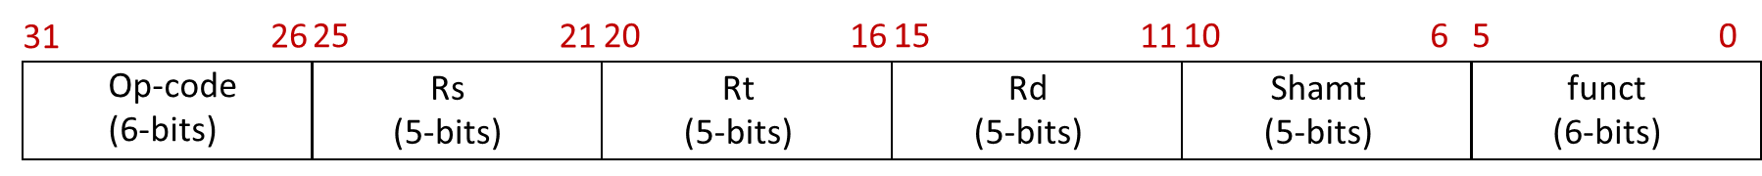
R-Type ALU Instructions
Adder
+4
ALU op
PC
Read Address
25:21
3
Rd Reg. 1
Read
Data 1
20:16
Instruction
Rd Reg. 2
ALU
result
15:11
Instruction Memory
Wrt Reg.
Read
Data 2
Wrt Data
Wrt Enable
“Datapath”
1

Slide 12
Example: Instruction at PC=0
4
Adder
+4
000000
00001
00010
00011
00000
010100
4
ALU op
0
PC
Read Address
00001
3
25:21
Rd Reg. 1
Read
Data 1
A21F FFB3
00010
20:16
Instruction
Rd Reg. 2
00011
ALU
result
15:11
BB33 CD53
Instruction Memory
Wrt Reg.
Read
Data 2
RF Contents
Wrt Data
0000 0000
00000
A21F FFB3
00001
Wrt Enable
BB33 CD53
00010
0
.
00011
1
1242 221E
.
A21F FFB3 | BB33 CD53
0001 0001
11111

Slide 13
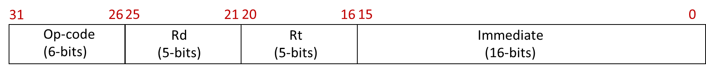
I-Type ALU Instructions
Adder
+4
ALU op
PC
Read Address
25:21
3
Rd Reg. 1
Read
Data 1
20:16
Instruction
Rd Reg. 2
20:16
ALU
result
15:11
Instruction Memory
Wrt Reg.
Read
Data 2
Wrt Data
15:0
Wrt Enable
32
1
Sign
Extend

Slide 14
Combined R-Type and
I-Type ALU Instructions
Adder
+4
ALU op
PC
Read Address
25:21
3
Rd Reg. 1
Read
Data 1
20:16
Instruction
Rd Reg. 2
ALU
result
Instruction Memory
15:11
Wrt Reg.
Read
Data 2
Wrt Data
I-Type?
a
Wrt Enable
a if (control = 1)
b if (control = 0)
1
I-Type?
MUX
15:0
Sign
Extend
b
control

Slide 15
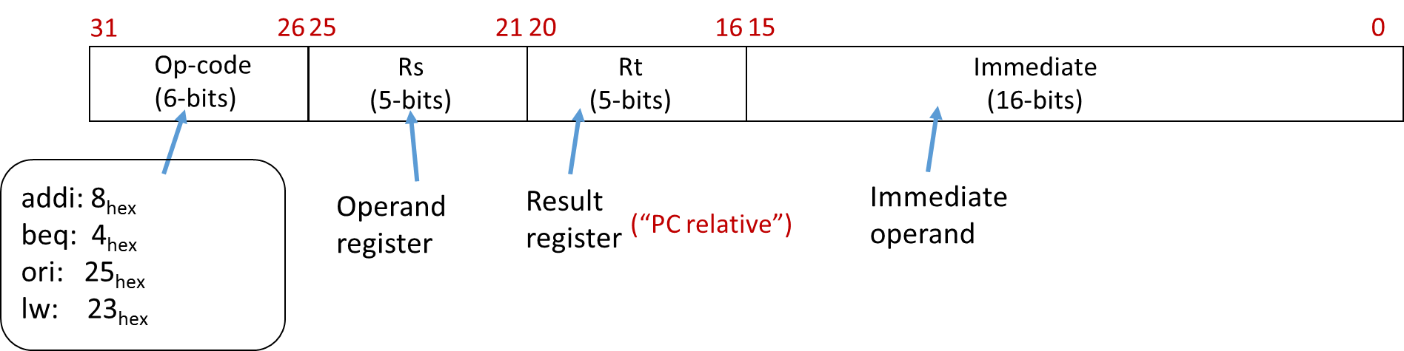
I-Type Load
Instructions
ALUOp = ?
25:21
3
Rd Reg. 1
Read
Data 1
Read Mem
Instruction
20:16
Rd Reg. 2
Instruction Fetch Part Not Shown
ALU
result
Address
15:11
Wrt Reg.
Read
Data 2
Wrt Data
I-Type?
Write
Data
Wrt Enable
Read Data
1
I-Type?
15:0
Sign
Extend
Data Memory
Write Mem

Slide 16
I-Type Load
Instructions
ALUOp = 001
25:21
3
IsLoad?
Rd Reg. 1
Read
Data 1
Read Mem
Instruction
20:16
Rd Reg. 2
ALU
result
Address
Instruction Fetch Part Not Shown
Wrt Reg.
Read
Data 2
15:11
Wrt Data
I-Type?
Write
Data
Wrt Enable
Read Data
1
I-Type?
15:0
Sign
Extend
Data Memory
Write Mem
0
IsLoad?

Slide 17
I-Type Store Instructions
sw rs, rt, imm //M[R[rs]+SignExtendimm] ← R[rt]
ALUOp = 001
25:21
3
isLoad?
Rd Reg. 1
Read
Data 1
Read Mem
Instruction
20:16
Rd Reg. 2
ALU
result
Address
Instruction Fetch Part Not Shown
Wrt Reg.
Read
Data 2
15:11
Wrt Data
I-Type?
Write
Data
Wrt Enable
Read Data
0
1
I-Type?
15:0
Sign
Extend
Data Memory
Write Mem
isStore?
In-Class Problem 2:
Did we miss something?
IsLoad?

Slide 18
Final Data-Path
(Excluding Control Flow Instructions)
ALUOp = 001
25:21
3
isLoad?
Rd Reg. 1
Read
Data 1
Read Mem
Instruction
20:16
Rd Reg. 2
ALU
result
Address
Instruction Fetch Part Not Shown
Wrt Reg.
Read
Data 2
15:11
Wrt Data
I-Type?
Write
Data
Wrt Enable
Read Data
!(IsStore?)
I-Type?
15:0
Sign
Extend
Data Memory
Write Mem
isStore?
IsLoad?

Slide 19
Control Flow
J-Type Control Flow
4 MSB bits taken from the 4 MSBs of PC+4
Next 26 bits taken from the “address” field
Last 2 bits are set to zero? (why?)
31
26
25
0
Op-code
(6-bits)
address
(26-bits)
j address // PC ← {PC+4[31:28], address, 00}, opcode=2_{hex}
(Erroneous in Lec. 2 notes, please update)

Slide 20
J-Type Control Instruction
J-Type?
31:28
Concat
PC+4
00
Adder
+4
25:21
RF Onwards Not Shown
Rd Reg. 1
Read
Data 1
25:0
20:16
Rd Reg. 2
PC
Read Address
15:11
Wrt Reg.
Read
Data 2
Wrt Data
Instruction
I-Type?
Instruction Memory
Wrt Enable
What about WrtEnable?
!(J-Type?)
!(IsStore?)
0
15:0

Slide 21
Control Flow
I-Type Branch Instruction
First 30 MSBs from sign extended immediate
2 LSBs are always 0
31
26
25
21
20
16
15
0
Op-code
(6-bits)
Rs
(5-bits)
Rt
(5-bits)
Immediate
(16-bits)
beq rs, rt, imm // If (R[rs]==R[rt])
// PC ← PC + 4 + {SignExtendImm, 00},
// else
// PC ← PC + 4
// opcode=4_{hex}

Slide 22
NextPC? = function(J-Type?, IsBranch?, IsEq?)
3:1 MUX
PC+4
31:28
Adder
Concat
{SignExtendImm[29:0],00}
PC+4
00
Adder
+4
29:0
25:0
25:21
Rd Reg. 1
Read
Data 1
IsEq?
20:16
=
PC
Rd Reg. 2
Read Address
15:11
Wrt Reg.
Read
Data 2
Instruction
Wrt Data
Instruction Memory
I-Type?
Wrt Enable
!(IsBranch?)
I-Type?
15:0
Sign
Extend

Slide 23
IsLoad?
Generating Control Signals
(Control Path)
IsStore?
Decoder
I-Type?
ALUOp
Wrt Enable
ALUOp
25:21
3
isLoad?
Rd Reg. 1
Read
Data 1
Read Mem
Instruction
Inst[31:0]
20:16
Rd Reg. 2
ALU
result
Address
Instruction Fetch Part Not Shown
Wrt Reg.
Read
Data 2
15:11
Wrt Data
I-Type?
Write
Data
Wrt Enable
Read Data
I-Type?
15:0
Sign
Extend
Data Memory
Write Mem
isStore?
IsLoad?

Slide 24
IsLoad? = (Inst[31:26] == 100011)
IsStore? = (Inst[31:26] == 101011)
Decoder
I-Type? = (Inst[31:26] != 00000) && (Inst[31:26] != 00010)
ALUOp
Wrt Enable
ALUOp
25:21
3
isLoad?
Rd Reg. 1
Read
Data 1
Read Mem
Instruction
Inst[31:0]
20:16
Rd Reg. 2
ALU
result
Address
Instruction Fetch Part Not Shown
Wrt Reg.
Read
Data 2
15:11
Wrt Data
I-Type?
Write
Data
Wrt Enable
Read Data
I-Type?
15:0
Sign
Extend
Data Memory
Write Mem
isStore?
Control Path
IsLoad?

Slide 25
If (Inst[31:26] == 100011) | (Inst[31:26] == 101011)
ALUop = 001
Else
ALUop = Inst[2:0]
Decoder
ALUOp
ALUOp
25:21
3
isLoad?
Rd Reg. 1
Read
Data 1
Read Mem
Instruction
Inst[31:0]
20:16
Rd Reg. 2
ALU
result
Address
Instruction Fetch Part Not Shown
Wrt Reg.
Read
Data 2
15:11
Wrt Data
I-Type?
Write
Data
Wrt Enable
Read Data
I-Type?
15:0
Sign
Extend
Data Memory
Write Mem
isStore?
Control Path
IsLoad?

Slide 26
J-Type? = (Inst[31:26]==000010)
IsBranch? = (Inst[31:26]==000100)
If (IsStore? | IsBranch? | J-Type?)
WrtEnable = 0
Else
WrtEnable = 1
WrtEnable
Decoder
ALUOp
25:21
3
isLoad?
Rd Reg. 1
Read
Data 1
Read Mem
Instruction
Inst[31:0]
20:16
Rd Reg. 2
ALU
result
Address
Instruction Fetch Part Not Shown
Wrt Reg.
Read
Data 2
15:11
Wrt Data
I-Type?
Write
Data
Wrt Enable
Read Data
I-Type?
15:0
Sign
Extend
Data Memory
Write Mem
isStore?
Control Path
IsLoad?

Slide 27
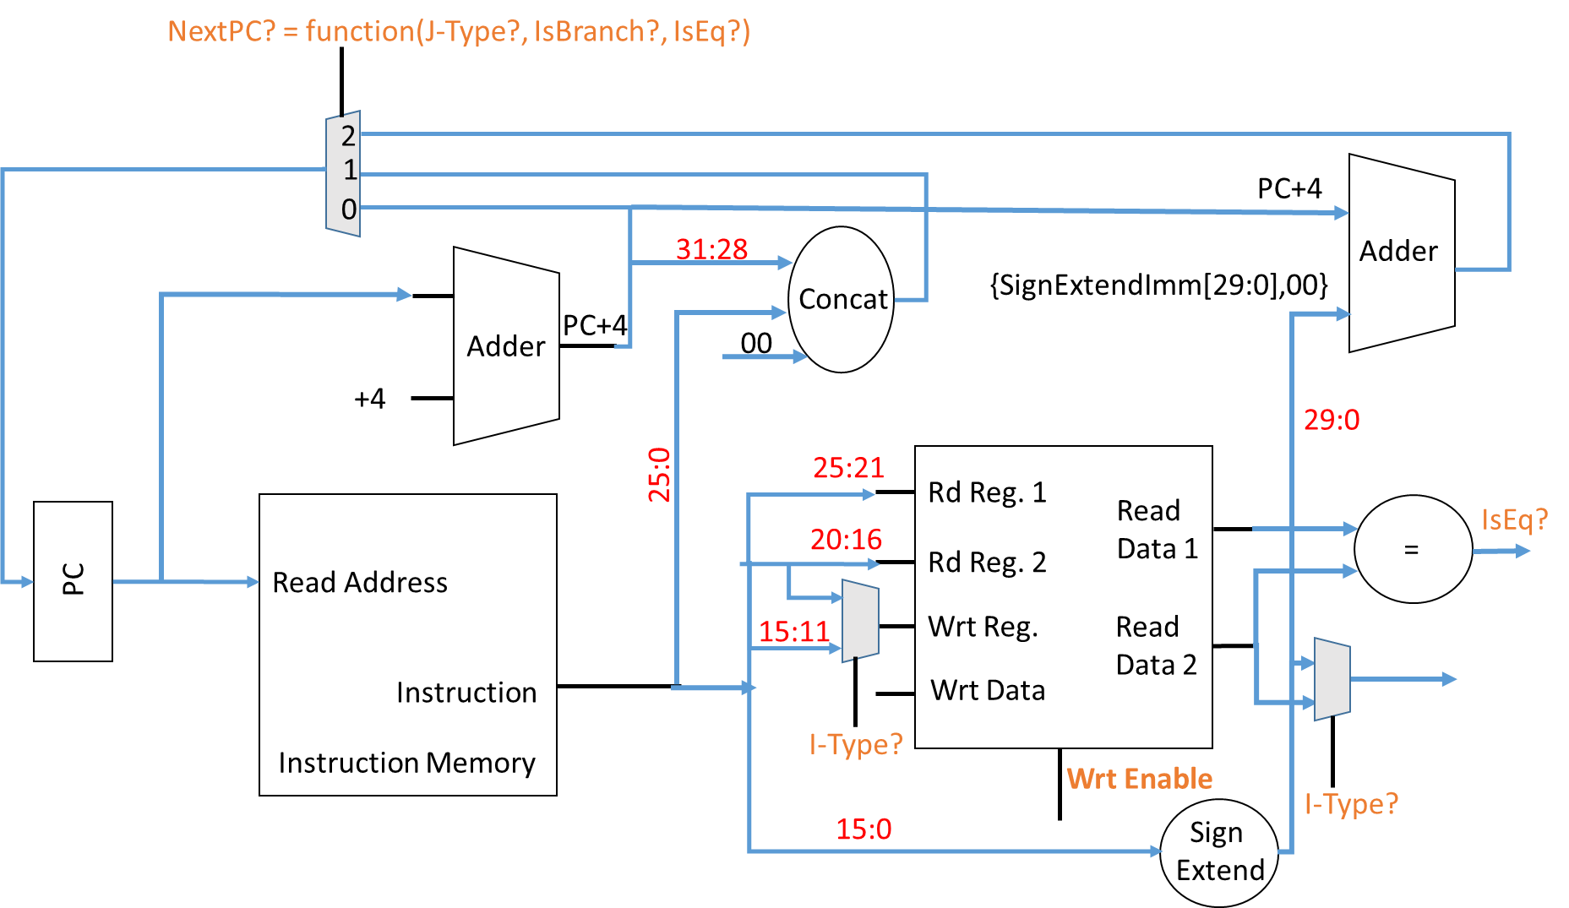
If (IsBranch? && isEQ?)
NextPC? = 2
else if (J-Type?)
NextPC? = 1
else
NextPC? = 0
In-Class Problem 3:
Write pseudo-code for NextPC?

